Slide 2
Education & Counseling &
Health equity
NUT 3700: Nutrition Education and Counseling

Slide 3
Objectives and Agenda
OBJECTIVES:
Describe the potential impact of culture, income, and bias on populations’ risk for disease and their adherence to health behavior recommendations
Demonstrate tailoring of interventions to affect change and enhance wellness in diverse individuals and groups.
AGENDA
Presentations
RECAP/Announcements
Tailoring Communication & Health Equity

Slide 4
Presentations

Slide 5
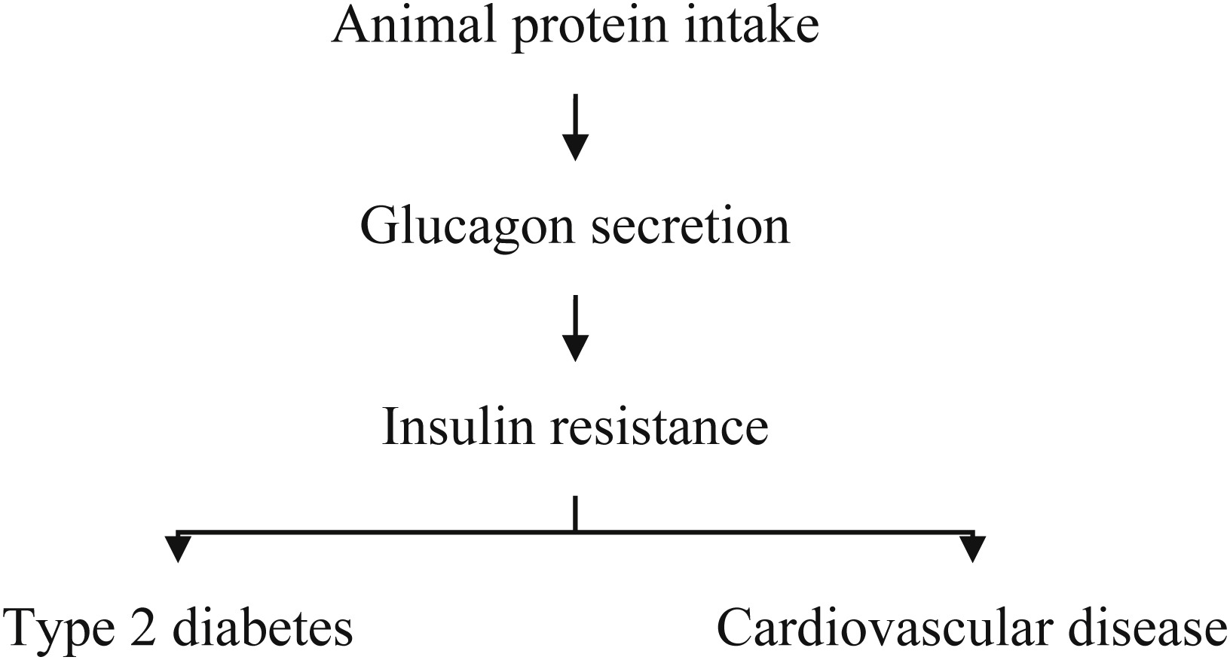

Fig. 1
Clinical Nutrition ESPEN 2019 33, 29-38DOI: (10.1016/j.clnesp.2019.05.014)
Copyright © 2019 European Society for Clinical Nutrition and Metabolism Terms and Conditions
Notes:
Animal protein intake increases the risk of type 2 diabetes and cardiovascular disease by intensifying insulin resistance.

Slide 6
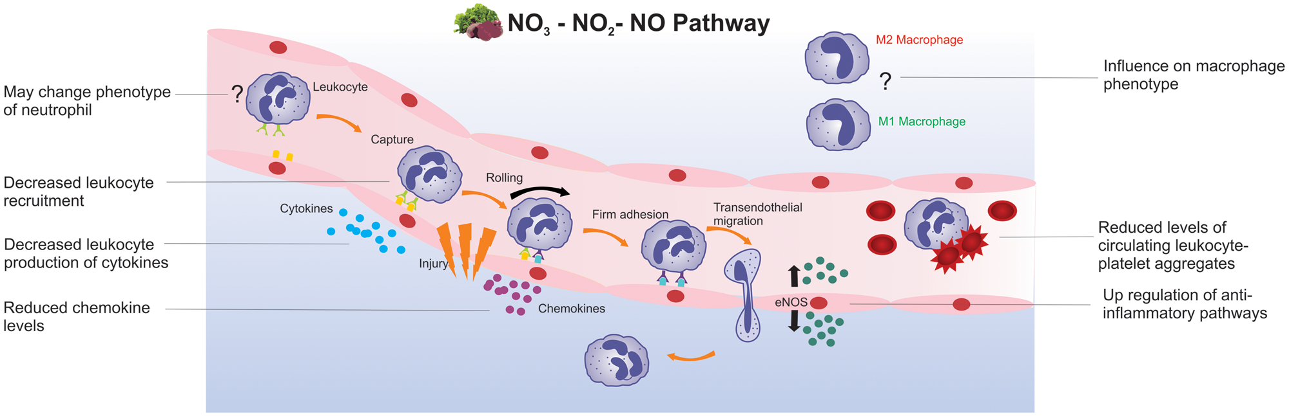

Figure 1 Proposed mechanisms by which inorganic dietary nitrate or nitrite exert anti-inflammatory effects, modulate ...
High Nitrate Veggies: lettuce, beets, carrots, green beans, spinach, parsley, cabbage, radishes, celery and collard greens
Notes:
Figure 1 Proposed mechanisms by which inorganic dietary nitrate or nitrite exert anti-inflammatory effects, modulate immune cell phenotypes and function, and immune–endothelial interactions. Mechanisms shown are based on data from cell culture, animal, and human studies. Abbreviations: eNOS, endothelial nitric oxide synthase; NO<sub>2</sub>, nitrite; NO<sub>3</sub>, nitrate.
Unless provided in the caption above, the following copyright applies to the content of this slide: © The Author(s) 2019. Published by Oxford University Press on behalf of the International Life Sciences Institute. All rights reserved. For permissions, please e-mail: journals.permissions@oup.com.This article is published and distributed under the terms of the Oxford University Press, Standard Journals Publication Model (https://academic.oup.com/journals/pages/open_access/funder_policies/chorus/standard_publication_model)

Slide 7
Re-CAP:
Practice?
Behavioral theories and how to apply them in life and professional practice.
Paper-based review of M5
Notes:
Example Intro:
Thank you for taking the time to be here today. Did you know that 1 in 8 women will develop invasive breast cancer in their lives? There’s about 25 people in the room. That means 3 women in this room are likely to have breast cancer in the future. Wow! I’m April Rhymaun and I’m an Outpatient Dietitian here at the hospital. After my talk today, you’ll know how to recognize the symptoms of breast cancer, how nutrition and healthy weight play a role in breast cancer prevention, and my five top nutrition tips for cancer prevention.

Slide 8
Mid-Course check-in
How is the class going for you?
What learning/activity opportunities and suggestions do you have for me and for the class?

Slide 9

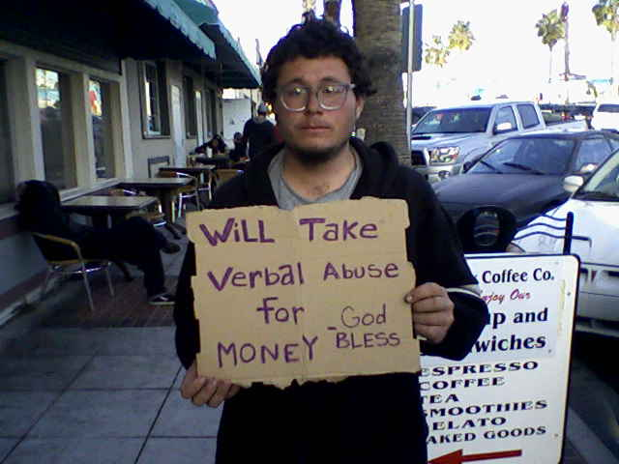
Both have values and money problems. Warren buffet has better ones.

Slide 10
What are your Values & valued Problems
What are your professional values?
What would you say are the problems that productive, satisfied, nutrition students enjoy working on?
What would you say are the problems productive, satisfied, nutrition professionals enjoy working on?
What do you aspire not to care about?
“There is not a more miserable human being than one in whom nothing is habitual but indecision”. William James

Slide 11
Each table presents 3 minutes on health equity
Concepts, facts, statistics, your group already knows from past classes or from personal exploration of the topic.
Stories, if any, illustrating problems that led to disparities.
Ideas you have for avoiding falling into existing health care “groves” that perpetuate disparities.
Explain what the group REALLY believes about “boot-strapping” healthy eating.
List the specific strategies you will use to overcome personal biases and meet people where they are (even if we don’t respect where they are).

Slide 12
Definitions
Racial and ethnic health disparities are defined as as inequalities that exist in the overall rate of disease incidence, prevalence, morbidity, mortality, or survival rates among members of certain population groups.

Slide 13
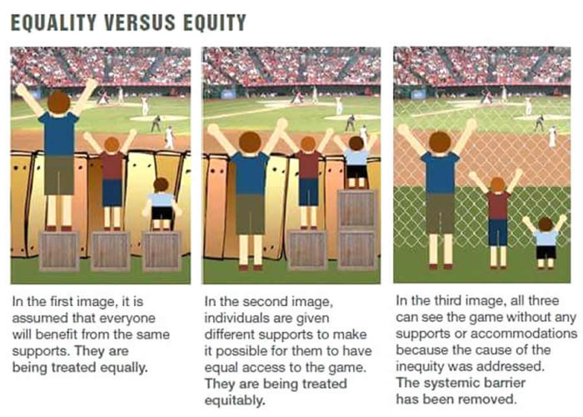

Slide 14
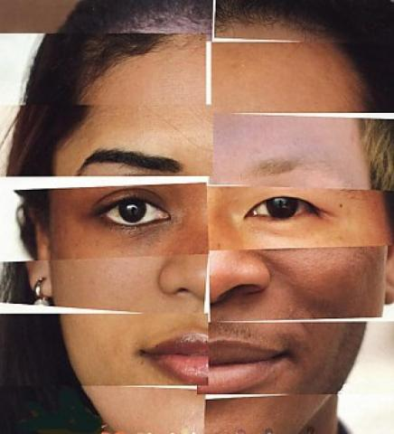
Promoting Racial and Ethnic Health Equity
Why do we care?
What do we already know?
Think?
Do about this problem?

Slide 15
Introduction Video
What are disparities?
Why do we have them?
http://www.unnaturalcauses.org/video_clips_detail.php?res_id=217

Slide 16
What are Differences vs. Disparities in Care
_{Differences}
_{Disparities}

Slide 17
What are Differences vs. Disparities in Care
_{Differences}
_{Different outcomes}
_{caused by:}
  _{Biology}
  _{Preferences}
  _{Access}
  _{Insurance}
  _{Resources}
_{Disparities}
_{Unexplained}
_{differences in}
_{outcomes}
_{associated with}
_{a variety of factors}

Slide 18
Social Factors and the Quality Gradient
_{Higher Quality}
_{Care}
_{Lower Quality}
_{Care}

Slide 19
Social Factors and the Quality Gradient
Education
Health Literacy
Income
Gender
Language
Living environment
_{Higher Quality}
_{Care}
_{Lower Quality}
_{Care}

Slide 20
Why Care?
What are the ethical considerations?
What are the financial considerations?

Slide 21
Economic Cost Of Disparities
Racial and ethnic health disparities cost the health care
system $23.9 million in direct costs in 2009.
Health disparities also have a great financial effect
on society in terms of human potential and efficiencies lost as a result of increased morbidity.

Slide 22
Lifetime cost of direct care
Diagnosis | Lifetime Cost Direct Care
Diabetes | $85,000
Stroke | $140,000
Heart Disease | $109,000
Kimberly Swartz The Hastings Center.

Slide 23
Health Professionals and Disparities

Slide 24
Health Professionals and Disparities
Bias, prejudice, and stereotyping by health care providers may contribute to differences in health care outcomes.
The bias is not necessarily malicious, but results from a
lack of understanding of other cultures, living situations, office time pressures, and uncertainty about a diagnosis or effect of a certain treatment.

Slide 32
Addressing the
social determinants of health
Primary prevention
Safety net programs and secondary prevention
Medical care and tertiary prevention

Slide 33
Are there differences in resources along the cliff face?
What should, generally, be done?
What could the nutrition profession do?
What could you do?

Slide 34
Toward Achieving health equity
Strategies for Everyone
Understand the importance of history and environment
Challenge the narrow focus on the individual
View systems and structures as modifiable
Find creative and effective ways to transform consumers to citizens
Break down barriers to opportunity
Build bridges to opportunity

Slide 35
Achieving health equity
Strategies for Clinical Dietitians

Slide 36
Achieving health equity
Strategies for Clinical Dietitians
The best solutions to health problems are usually in the client.
Link your clients with options free and low-cost nutrition services for ongoing education, diabetes supplies and food.
Be flexible with nutrition guidelines and take into consideration ethnic and traditional food-ways.
Collaborate with other services including social services, nursing, and physical therapy and pharmacy.
Offer food and nutrition programs in varying languages.

Slide 37
Achieving health equity
Strategies for Clinical Dietitians
Collaborate with Physical Therapy to provide an exercise program for low-income clients.
Work with employers to offer free health screening with nutrition education.
Promote client follow-up phone calls for questions that arise after discharge or screenings.
Partner with local dentist to offer low-income clients services.
Be proactive in hiring a racially, ethnically and age-related diverse population of employees.

Slide 38
Achieving health equity
Strategies for Public Health Dietitians

Slide 39
Achieving health equity
Strategies for Public Health Dietitians
The best solutions are in the communities you serve.
Build upon native, indigenous and ethnic foodways to offer sustainable lifestyles recommendations.
Identify leaders to serve as community nutrition advisors.
Seek insights from community advisors on how to craft messages for their communities.
Seek collaborations with neighborhood grocery stores.

Slide 40
Achieving health equity
Strategies for Public Health Dietitians
Demonstrate healthy cooking tips with foods from diverse cultures.
Assess low-literacy materials for the local community citizens on health and nutrition issues.
Develop new educational materials as needed to reflect the appropriate literacy and cultural factors.

Slide 41
Counseling Considerations

Slide 42
Counseling Considerations
Flexibility in scheduling.
Check your space, resources and handouts.
Observe and mirror nonverbal clues.

Slide 43
Counseling Considerations
Show understanding, curiosity, respect and…seek first to understand.
Match objectives to the client(s).
Use the teach-back method
Use a translator

Slide 44
TEACH Back Method
https://www.youtube.com/watch?v=cllXBnHBiD4
https://www.niddk.nih.gov/health-information/professionals/clinical-tools-patient-management/diabetes/game-plan-preventing-type-2-diabetes/how-talk-patients-about-prediabetes-diagnosis/use-teach-back-method

Slide 45
Teach back method Activity
Pretend we are well into the counseling session. You have already introduced yourself, learned what the client knows, wants to know, etiology, etc.
Ask permission to provide information.
Provide your “911” nutrition information.
Introduce the teach back method.
Show using the teach back method.
As you watch others’ demos, use 10-tips handout to check peers’ techniques.

Slide 46
Reflective listening
In a reflection, you repeat back the true meaning of what someone is saying.
You get at underlying feelings, values, and perspectives.
A reflection calls attention to what the client has already said. (be careful what you call attention to).
A reflection is a guess and you can get it wrong (but that is okay).
Your voice turns down at the end of a reflection (not up as it would if it were a question).
It’s brief (5-10 words) and you shut up after giving it.
After a reflection, clients will either keep going or correct you. In both cases, there is new understanding.

Slide 47
Course Review
Strategies for teaching adults and planning adult education programs;
Careers, collaborators, and resources for clients and professionals
Counseling techniques of introductions, active listening, empowerment approach, and minimal encouragers.
Billing, coding, and overall financials of nutrition practice
Written communication with health care teams to support coordination of care
Behavior change theories for consideration in counseling interventions
Health Equities and Tailoring Communication

